Slide 1
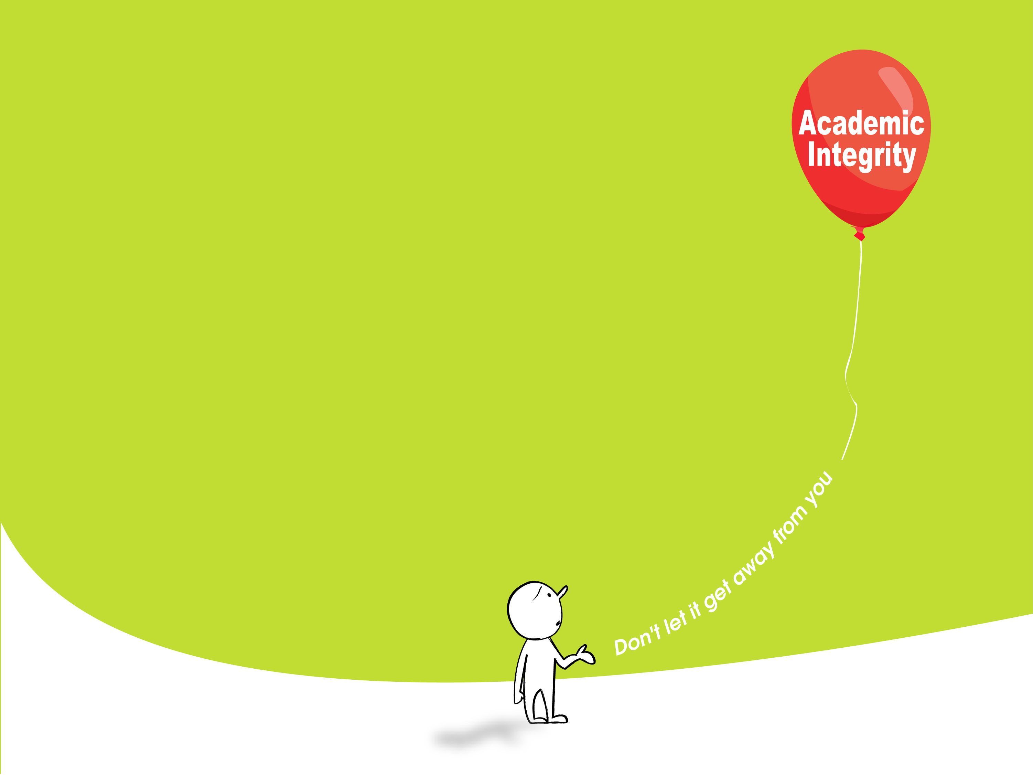
About
Plagiarism
and
How To Avoid It
The Hong Kong Polytechnic University

Slide 2
This Session:
What is plagiarism?
Why is it important to avoid it?
How to avoid plagiarism in your own work?
How to properly cite other peoples’ ideas or work in your work?
Where to get help?
Any questions?

Slide 3
Welcome to the University!
Welcome to a place for
higher learning !

Slide 4
What counts for good work at U?
NOT just to reproduce knowledge presented by your teachers/in textbooks/experts
BUT rather to
develop deep understanding
question other people’s ideas or views
exercise personal judgments
produce original ideas and formulate own views
create new knowledge
All of these are built on other people’s work

Slide 5
A higher expectation for academic writing about….
How to properly acknowledge and use other people’s ideas, creations or other forms of work in your own work

Slide 6
What is Plagiarism?

Slide 7

What is Plagiarism? [抄襲 , 剽竊]
“ Plagiarism is passing off someone else’s work, either intentional or unintentional, as your own for your own benefit.” (Carroll, 2002)
“Benefit” may mean:
  Not having to do the hard work yourself
  Meeting a deadline so marks are not lost
  Getting a better grade / higher marks
  Getting an advantage in competition for scholarships, chances for further education or a job

Slide 8
More definitions
“ … copying the work of another person without proper acknowledgement. ” (HKU)
“ … the act of representing as one’s own original work the creative works of another, without appropriate acknowledgement of the author or the source. ”
This covers:
  Published and unpublished works
  Written documents, interpretations, software, designs, images, sounds, … ideas or ideological frameworks… (The University of Melbourne)

Slide 9

How much do you know about plagiarism ?
Plagiarism is something you cannot hide from. Knowing about it can keep you out of trouble!

Slide 10
Test your understanding
QUIZ
You will see 5 cases
Decide whether or not each case is plagiarism
Choose YES if you think it is plagiarism
Choose NO if you think it is not plagiarism
Choose NOT SURE if you are not sure
Are you ready?

Slide 11



This is Case 1. Let’s use it to test your knowledge (and the function) together!
Copy from a classmate and submit the work as your own
(a)
(b)
(c) Not sure

Slide 12
YES. This is definitely plagiarism.
(a)

Slide 13
Case 2
Write about generally accepted facts and don't give the source
(a)
(b)
(c) Not sure

Slide 14
NO. When you write about common knowledge
(i.e. generally accepted views or facts),
you do not have to acknowledge.
(b)

Slide 15
Case 3
Hand in the same assignment for more than one subject
(a)
(b)
(c) Not sure

Slide 16
YES. This is self-plagiarism.
Although you are copying from your own work,
you still need to acknowledge.
(a)

Slide 17
Case 4
Modify a diagram you get from a website and include it in your work submitted without mentioning where you get the original.
(a)
(b)
(c) Not sure

Slide 18
YES. This is plagiarism.
Remember we mentioned the definition of plagiarism
earlier as “copying the work of another person”?
This includes ALL FORMS of work, not just text.
(a)

Slide 19
Case 5
Allow your own work to be copied by another student who then submits it for marking.
(a)
(b)
(c) Not sure

Slide 20
NO. This is not plagiarism.
However, this is Academically Improper.
So, you MUST AVOID it.
(b)

Slide 21

More examples of plagiarism
  Pay someone to do an assignment for you
  Copy a few sentences that someone else has written but
  change a few words to make it look different from the original
  Copy material, without acknowledgement, from the Internet
  Copy a photo from an encyclopedia without proper acknowledgement
  Hand in the same assignment for more than one subject

Slide 22
So, what is/are academically proper?
  Always acknowledge/cite properly
    other people’s work included in your work, and
    help you have got in doing the work
  You do NOT have to acknowledge only when you write about
  your own ideas, views, observations or experiences in your own words
  First-hand data or experimental results you gather yourself
  Common knowledge (i.e. generally accepted views or facts)

Slide 23

Stop and think
Any confusion?
Any questions?

Slide 24
Why is it important to avoid it?

Slide 25
Why PolyU teachers are concerned about Plagiarism?
It is because they want you to
Maximise your learning
Really acquire the knowledge and skills you need to get and do well on a job
Develop a sense of academic/professional integrity
Have bright future prospects
Help protect the reputation of the University and its graduates

Slide 26

PolyU Rules (regulations)
Plagiarism is a serious offence and there are
Penalties including:
A lower grade or fail
A lower degree classification
Suspension
Expulsion
Both intentional and unintentional plagiarism
will be penalised
No gain, ALL PAIN!

Slide 27
PolyU cases
2006: A Year 2 student found to have submitted a final report copied directly from a journal on the Internet failed the subject concerned, got subject to the penalty of having overall classification on graduation lowered by one level
2005: A PhD student found to have submitted a plagiarised assignment expelled from study
2003: a part-time Year 2 student found to have submitted a dissertation copied directly from another dissertation failed and got one level lower on award classification on graduation.
There are many more…

Slide 28
Cases at other universities
HKU (2004)
  2 Postgraduate Certificate in Law (PCLL) students expelled for plagiarism
MIT (02-03)
  MIT punished students for plagiarism: 21 of the students received notations on transcript
  Among these cases, 5 degrees withheld, 1 graduate degree revoked, 8 students suspended

Slide 29
Cases at other universities
University of Regensburg (2008)
  doctoral thesis of a law student found plagiarised, university decided to rescind the doctoral title award
Ohio University (2007):
  1 graduate’s master degree revoked
  12 graduates required to rewrite all or parts of their theses and defended it again
  It follows you FOR LIFE!!

Slide 30
How to avoid Plagiarism in your own work?

Slide 31
You can avoid it!
Much of student plagiarism is UNINTENTIONAL due to:
  Lack of clear understanding of what constitutes plagiarism
  Not aware of the importance of acknowledging other people’s work
  Not knowing how to cite other people’s work properly in academic writing (referencing skills)
  Not understanding what is acceptable for collaborative efforts in assessment tasks

Slide 32
Should I use other people’s ideas or writings in my own work?
Definitely – but remember to acknowledge the sources EXPLICITLY and PROPERLY
It adds strength and quality to your work!
  Shows breadth and depth of your understanding of the topic
  Demonstrates critical reading
  Establishes credibility of your claims
  Provides evidence/support for your argument
  Allows others to follow your references
Notes:
-

Slide 33
How to cite other people’s work?
Common citation styles used at PolyU: APA (American Psychological Association) style & Vancouver Referencing Style
Online resources on proper citation:
  http://wwwlib.murdoch.edu.au/find/citation/
  http://library.curtin.edu.au/referencing/

Slide 34
Two Ways of Citation
Using direct quotations
  Indent the quotation
  Start on a new line
  Use ellipsis (…) to indicate omission
  No quotation marks are required
  Example in APA style:
One of the definitions for conflict within the marketing channel was
established by Stern and Gorman (1969). Their view was that a conflict
was a process of system changes:
  ... a change occurs in the task environment or within a channel
  member’s organization that eventually has implications for the
  channel members ... when the other affected members perceive the
  change as cause of frustration a conflict situation emerges. (p. 58)

Slide 35
Two Ways of Citation
Using direct quotations [for <30 words]
  Use quotation marks …
  Example in APA style:
According to Chan (2003), “the experiment must be repeated several times
for reliability and validity” (p. 46). Brow (2004) also points out that “this is of
paramount importance” (p. 185).

Slide 36
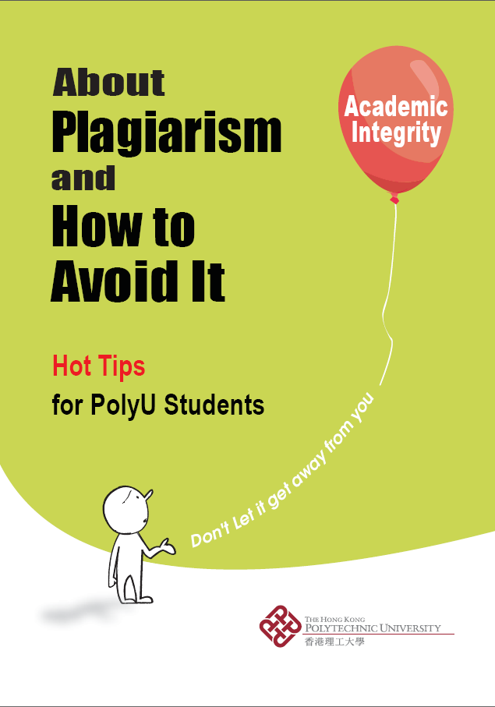
Two Ways of Citation
2. Paraphrasing
  To paraphrase, you express the information using your own words. But you still need to cite the sources with bibliographic information so that your readers can trace the items
  Check out the student booklet at
  http://edc.polyu.edu.hk/PSP/teacher.htm
  to find out more

Slide 37
A Tour to an interactive online tutorial on citation and referencing
The tutorial is called “You Quote It, You Note It”
It will take about 10 minutes
You may take notes of the contents useful to you, during your tour
Have fun with the tutorial at http://library.acadiau.ca/tutorials/plagiarism/

Slide 38

Remember! Use Other People’s Work
(you learn from them) BUT Avoid Plagiarism
A
little PAIN but MUCH to GAIN!
Always cite your sources
Know expectations
  What’s the difference between collaboration and collusion?
Develop your referencing skills
Play safe
  Be careful how you share your work
  “When in doubt, acknowledge!”

Slide 39
Where to get help?

Slide 40
Help from within PolyU
PolyU website on plagiarism for students http://edc.polyu.edu.hk/PSP/student.htm
PolyU English Language Centre (ELC)
Writing Assistance Programme: http://elc.polyu.edu.hk/WAP/
“Using outside sources” (ELC) http://elc.polyu.edu.hk/elsc/material/Writing/using.htm
“Reference Machine” (ELC) http://elc.polyu.edu.hk/cill/referenceMachine.htm
PolyU Library Online Information Literacy Programme
Module 4 Managing Information: http://www.lib.polyu.edu.hk/collser/libguides/literacy/module2_4/manage0.htm

